Slide 1

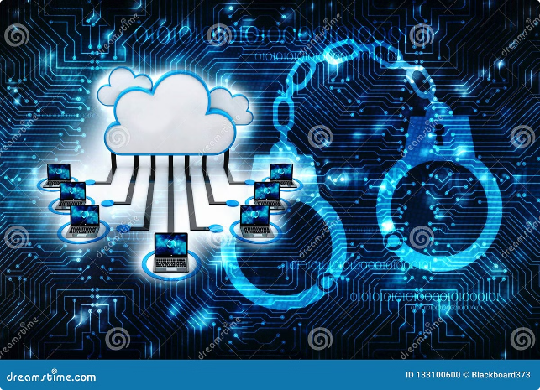
Introduction to Risk Analysis on the Cloud
Cloud computing has transformed the way businesses operate, but it also presents unique challenges for risk management. This presentation explores the evolution of risk analysis in the cloud era, focusing on developing a comprehensive platform for proactive risk mitigation.
D Sai Venkat Krishna
192210328
CSE

Slide 2
Assessing Risks Across Domains
Cyber Security
Financial Risk
Operational Risk
Cybersecurity threats are becoming increasingly sophisticated, targeting cloud infrastructure with data breaches, malware attacks, and denial-of-service attacks.
Financial risk in the cloud encompasses data integrity, financial fraud, and compliance with regulations like PCI DSS and GDPR.
Operational risks include system downtime, service outages, and disruptions to cloud-based services, affecting business continuity.

Slide 3

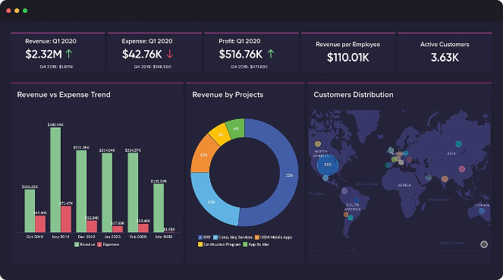
Developing a Comprehensive Risk Management Platform
1
Risk Identification
The platform should identify potential threats across various domains, including cybersecurity, financial, operational, and compliance.
2
Risk Assessment
The platform must assess the likelihood and impact of each identified risk, allowing for prioritization and resource allocation.
3
Risk Mitigation
The platform should propose and implement effective mitigation strategies, including security controls, policies, and procedures.
4
Continuous Monitoring
Real-time monitoring and automated alerts are crucial for early detection of potential threats and rapid response to security incidents.

Slide 4


Leveraging Cloud Infrastructure for Scalability
Elasticity
Cloud infrastructure provides dynamic scalability, enabling resources to be allocated and adjusted on demand to meet changing risk assessment needs.
Automation
Automating risk analysis tasks, such as vulnerability scanning and compliance audits, streamlines processes and reduces manual errors.
Data Analytics
Cloud-based data analytics platforms facilitate the analysis of vast amounts of data, enabling the identification of patterns and anomalies.

Slide 5

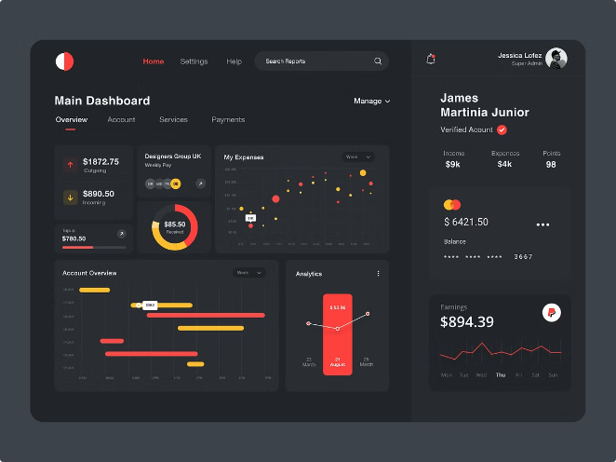



Implementing Automated Risk Monitoring and Alerting
Real-time Monitoring
Continuous monitoring of cloud environments, including security logs, network traffic, and user activity, is crucial for early detection of threats.
Automated Alerting
Alerting mechanisms should be configured to trigger notifications when suspicious activity or potential vulnerabilities are detected.
Incident Response
A defined incident response plan ensures swift and effective action to contain and mitigate security threats.

Slide 6
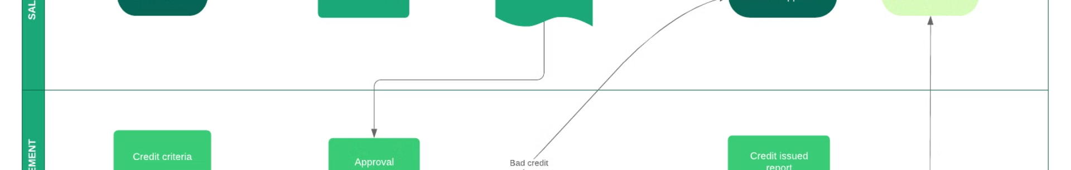
Integrating with Existing Systems and Workflows
Integration with Existing Security Tools
Seamless integration with existing security information and event management (SIEM) systems, firewalls, and intrusion detection systems.
Integration with Compliance Platforms
Integration with compliance management tools to streamline audit processes and ensure adherence to relevant regulations.
Integration with Business Processes
Integration with business processes to automate risk assessment and mitigation activities, streamlining workflows and improving efficiency.

Slide 7





Ensuring Compliance and Regulatory Adherence
Data Privacy Regulations
Compliance with data privacy regulations, such as GDPR and CCPA, requires robust data protection measures and access controls.
Security Standards
Adherence to industry security standards, such as ISO 27001 and NIST Cybersecurity Framework, demonstrates commitment to security best practices.
Auditing and Reporting
Regular audits and reporting provide evidence of compliance and demonstrate a commitment to risk management practices.

Slide 8


Conclusion: Transforming Risk Management in the Cloud Era
By implementing a comprehensive cloud risk management platform, organizations can proactively assess, mitigate, and manage risks associated with cloud adoption. This approach empowers businesses to embrace the benefits of cloud computing while minimizing potential threats.

Slide 9


